Slide 1
Information Theory

Slide 2
Agenda
Introduction
Entropy
Huffman encoding
Predictive compression

Slide 3
What is Information Theory?

Slide 4
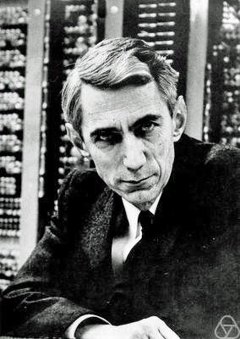
Mathematical properties
of data
Claude Shannon

Slide 5
There was a law in the city of Athens which gave to its citizens the power of compelling their daughters to marry whomsoever they ________
Tales from Shakspeare (1831)
A Midsummer Night's Dream

Slide 6
There was a law in the city of Athens which gave to its citizens the power of compelling their daughters to marry whomsoever they pleased.
Tales from Shakspeare (1831)
A Midsummer Night's Dream

Slide 7
When the fairies had sung their queen asleep with this pretty lull_ ….
Tales from Shakspeare (1831)
A Midsummer Night's Dream

Slide 8
When the fairies had sung their queen asleep with this pretty lulla ….
Tales from Shakspeare (1831)
A Midsummer Night's Dream

Slide 9
Agenda
Introduction
Entropy
Huffman encoding
Predictive compression

Slide 10
Entropy
Measurement of choice
How many bits does it take to encode the data

Slide 11
Deterministic Data
0000000000000000000000000
100% => 0
E = 0

Slide 12
Coin Flip
100101010101110110011101
50% => 0
50% => 1
E = 1

Slide 13
Agenda
Introduction
Entropy
Huffman encoding
Predictive compression

Slide 14
Agenda
Introduction
Entropy
Huffman encoding
Predictive compression

Slide 15
Questions

